Slide 1
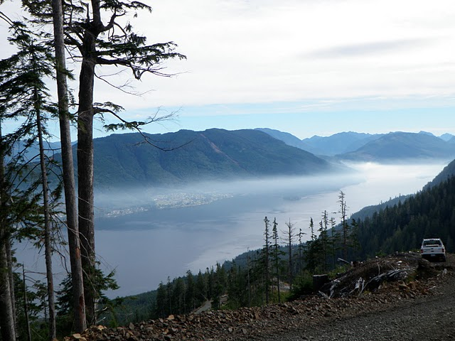
FREP Mission
...communicating science-based information to enhance the knowledge of resource professionals and inform balanced decision making and continuous improvement...
Notes:
The FREP mission, goals, priorities and focus areas are aligned with the MFLNRO vision and commitment statements, the Ministry service plan and the provincial strategic plan.
2011/12 Provincial Strategic Plan: “Lead the world in sustainable environmental management...”
MFLNRO Vision: Economic prosperity and environmental sustainability
MFLNRO Commitment Statements: As a ministry we:
Make informed, integrated and durable resource management decisions
Based on science, best knowledge and an understanding of cumulative effects
Supported by clear standards, objectives, effectiveness monitoring, and an integrated compliance and enforcement framework
Collaborate with our partner agencies and others to achieve government’s priorities efficiently and effectively
streamlined permitting, easy access to quality, efficient client services and enhanced predictability on outcomes
sharing data, ideas and resources to optimize outcomes
responsive and adaptive to our changing environment, public and client needs
Are empowered, proud to belong, equipped to do our jobs, and encouraged to learn and grow

Slide 2
Results-based, Professional Reliance Model
FRPA
Plan &
Compliance
Objectives
Practice
and
Requirements
Enforcement
Professional Reliance
Effectiveness Evaluation
Notes:
Government committed to enhanced “back end monitoring and C&E” in exchange for a results based framework which gave licensees more freedom to manage
FREP is the foundation of the results based framework
As all resource sectors move towards results based/ professional reliance – it is critical that we succeed with the first “test case” – and we can’t succeed without adequate monitoring
High profile example outside of BC:
Quote from Peter Kent (Federal Minister of the Environment) on oil sand monitoring: "You can't do proper regulation, you can't do proper enforcement and you can't do very much until you have the scientific data to back up your decisions."

Slide 3
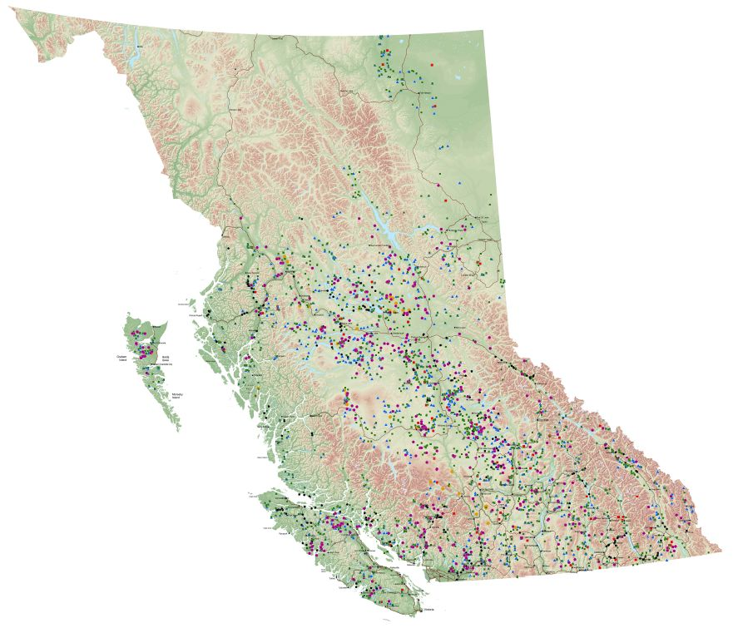
FREP
Sampling
Locations
>5000 samples
10 of 11 resource values
Notes:
District staff collect data
Staff are trained – have become the local experts
Have monitored mostly the impacts of FPC – now monitoring FRPA – need to close the loop – but need samples to do so.
Have collected data on 10 of 11 FRPA values - - 11th value (wildlife) has no data yet, but have completed some key development work (e.g., mountain goat, badger, tailed frog protocols etc.)

Slide 4
    Communication to maximize use of data and findings
Uses of FREP
Professional Reliance
Results Based Forestry
Climate Change
Compliance & Enforcement
Knowledge of Land Base
Policy & Legislation
Certification
Cumulative Effects
Relationship Building
Notes:
Have identified 9 broad areas where FREP has an impact

Slide 5
Relationship
Building
“Since the proponent company's representative was present, he saw what had been done. Immediately he prepared for a meeting with the Bands to discuss this and establishment of a better prevention and management strategy. ”
Mary Sandy , Esh-kn-am Joint Ventures (Cook’s Ferry, Siska, and Coldwater Indian Bands)
Certification
“...you have given me exactly what I need to confirm that FREP surveys are relevant to Criterion 9.4 in the FSC BC Standard. How or whether the member companies choose to use these to move to conformance with 9.4 is up to them...” FSC Certification Auditor
Professional Reliance
“… the specialized knowledge that professionals bring to their practice…professionals, on a regular and consistent basis, maintain a currency of knowledge and incorporate this knowledge into their practice. “
... Mike Larock, ABCFP
Notes:
Examples – quotes from people outside government
These three areas have huge potential – as does CE
Certification uses of FREP can save industry significant expenditures – industry may be able to help offset some costs (e.g., paying for flights etc.) if they see the full value
Value added to Professional Reliance includes:
Training (currency of knowledge – skills development)
Protocols and indicators (knowledge of most critical aspects of each resource value)
Data (ability to see their results – outcomes of their practices)
Results--extension products (maintaining currency of knowledge)
Recommendations for continued improvement of practices (e.g., CF Report)
Resource Value Team Leads (provincial expert knowledge)
District field staff (local resource value experts)

Slide 6
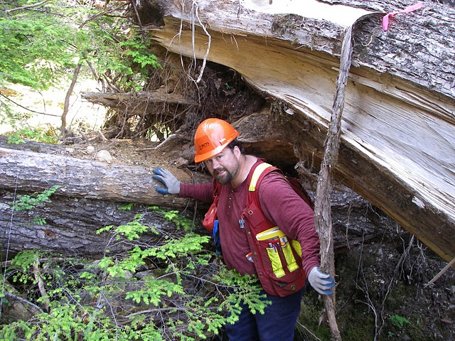
FREP Tools for Professional Reliance
  Training (currency of knowledge – skills development)
  Protocols and indicators (knowledge of most critical aspects of each resource value)
  Data (ability to see their results – outcomes of their practices)
  Results--extension products (maintaining currency of knowledge)
  Recommendations for continued improvement of practices (e.g., CF Report)
  Resource Value Team Leads (provincial expert knowledge)
  District field staff (local resource value experts)

Slide 7
More uses of FREP
CF Policy/Guidance on CWD
TSR rationale data
FSP renewals
Assigning priority expenditures to recreation sites
Use in non-FREP reports
Developing expert skills in district staff
Media responses
Ministry profile
Protocols used outside of FREP (e.g. Placer mining, MOE urban stream, certification, Clayoquot Sound, C&E)
Maintaining our social licence
Notes:
Additional examples and potential include:
Cumulative effects – indicators, data, staff, experts ...
C&E evidence
Climate change response decisions
Water Act Modernization
First Nations stewardship planning
FN Reasonable Opportunity Agreements
BCTS management activities

Slide 8
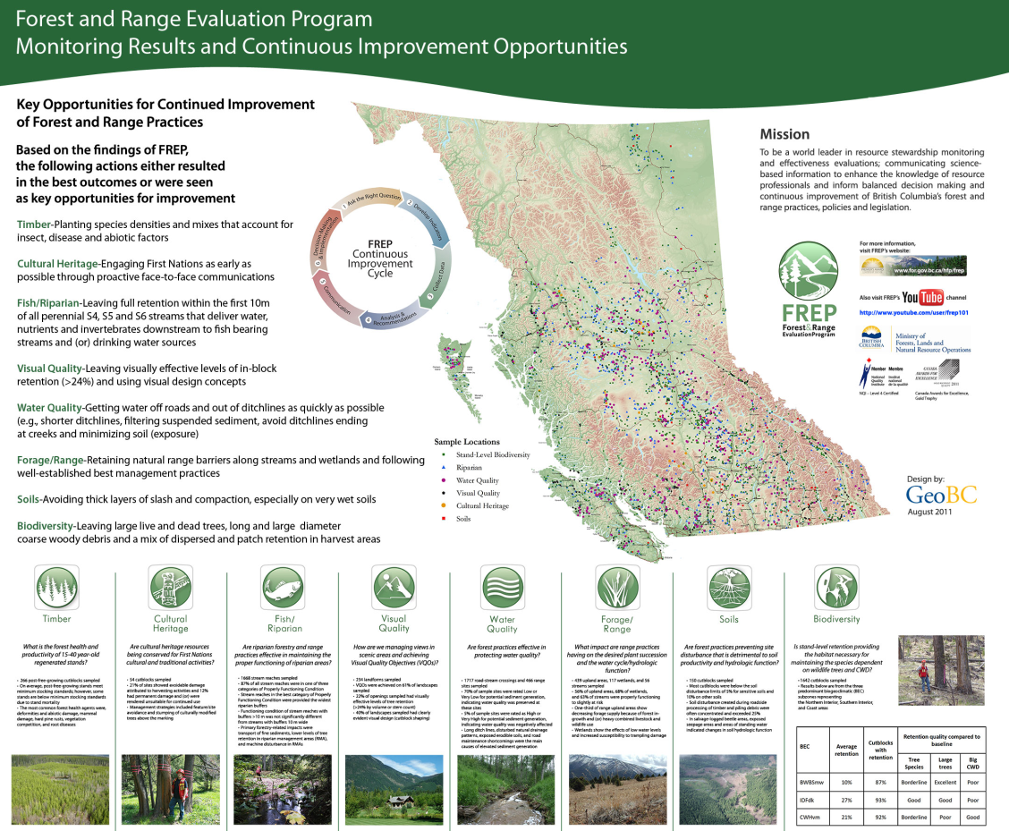
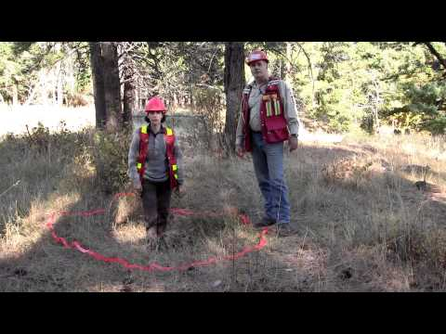
Communicating Results: Impacting decision making and professional reliance
>30 reports
>20 extension notes
>10 YouTube videos
2 CF Reports
>20 others extension products
Notes:
Significant effort has been made in communicating FREP (indicators, data, results, recommendations etc.)
YouTube Videos
Reports
Extension Notes
Presentations (licensees, PAC, Academic, SISCO, ABCFP, etc.)
Posters
Individual licensee presentations (their data)

Slide 9
FREP over the next 2-3 Years
  Implement the Strategy (3 key focus areas)
  Quality
    Communication
    Continuous Improvement
    Strategy Includes:
  Multiple resource value assessment
  Landscape-level (biodiversity and other values)
  Cumulative effects
  Multi-sector approach
Notes:
Strategy signed off by CF in November 2011 (endorsed by REDs)
Need to close the loop in 2012 by reporting on FRPA – but need enough samples to do this
Would like to expand monitoring into more multi-sector (oil and gas, independent power, mining operations, EAO, CE...) – but danger of thinning out staff resources too thinly and not being able to meaningfully report

Slide 11

Visual Quality Evaluation
Goal:
to determine if the FRPA model is effective at managing and protecting the visual resource.
Between 2006 and 2008 the FREP program randomly sampled visual openings harvested under the Code.
Extension Note #13 was released in 2010 summarizing the
results of the Code sampling provincially.
In 2008 FREP began sampling FRPA (FSP) openings across the province to determine the effectiveness of managing visuals under FRPA.

Slide 12
What have we learned?
Code Results WFP
FRPA Results WFP
Practices consistent with VQO’s 45% of the time.
Practices consistent with VQO’s 75% of the time.
The move from Code to FRPA has resulted in a 30% Improvement in achieving VQOs.
Provincial Average 67%

Slide 13
Code - FRPA Comparison
Code Results WFP
FRPA Results WFP
Modification was achieved 67% of the time while Partial Retention was achieved 44% of the time.
Modification is achieved 75% of the time while Partial Retention is achieved 75% of the time.
Considerable improvement in achieving all VQO classes.
Provincial Average for Partial Retention 67%
for Retention 46%

Slide 14
Code - FRPA Comparison
Code Results WFP
FRPA Results WFP
Good visual design was achieved on 30% of the samples.
Good visual design was achieved on 25% of the samples.
Visual Design has stayed about the same, but is behind
provincial average 37%.

Slide 15
Code - FRPA Comparison
Code Results
FRPA Results
35% of the openings sampled contained
Moderate amounts of tree retention.
(Poor = 15% or less. Moderate is 15-22%)
100% of the openings sampled contained less than 15 % tree retention.
The proportion of WFP openings containing tree retention has dropped significantly.
Provincially 13% good, 14 % moderate and 73% poor.
Public perception studies have found that leaving less than 15% volume/stems
is not acceptable visually, whereas leaving 24% or more is always acceptable.

Slide 16
Preliminary Observations
VQOs are being achieved at a considerably higher rate.
(45% under CODE to 75% under FRPA) Provincial Average 67%.
Definite improvement in achieving restrictive VQOs such as PR. (44% under Code & 75% under FRPA) PR not achieved 25% of the time so there is still room for improvement.
Visual design does not appear to have improved moving from Code to FRPA. This remains an area in need of improvement.
35% of Code openings contained moderate amounts (15-22%) of retention. 92% of FRPA openings sampled contained low (>15% ) in block retention. Provincially 73% openings >15%.

